Slide 1
Connecting the Dots: Behavioral Supports and Academic Outcomes
When considering the success of student learning, ensuring students are in a safe, consistent and positive environment then ensures academic growth and ultimately success. Academics (CA Dashboard) and PBIS (TFI) come together to meet the need of the “whole child.”

Slide 2
Annual Fidelity Measurements
PBIS Tiered Fidelity Inventory (TFI): a tool that is used by school site teams to determine implementation fidelity of the PBIS Framework to best support student, staff, parent/guardian, and community need.
California Dashboard: California’s accountability and continuous improvement system provides information about how LEAs and schools are meeting the needs of California’s diverse student population. This system is based on multiple measures that assess how LEAs and schools are meeting the needs of their students. Performance on these measures are reported on the California School Dashboard.
Notes:
TFI- tool for implementation fidelity PBIS
Dashboard-How LEAs and schools are meeting the needs of diverse student population.

Slide 3
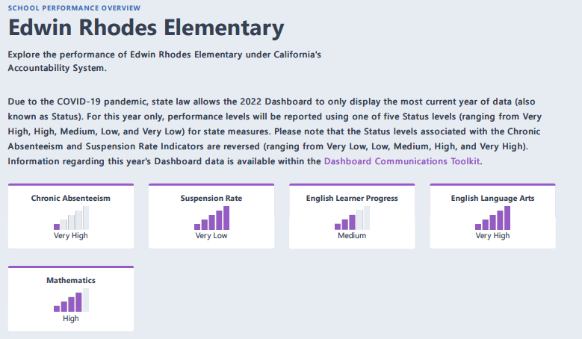
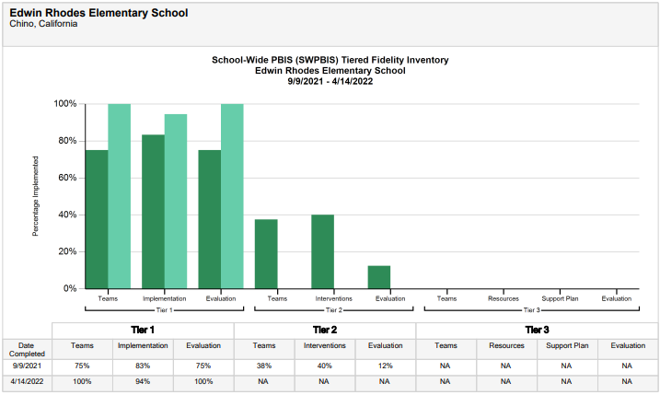
PBIS TFI Results 21-22 School Year
Year By Year Comparisons of PBIS and Academic Outcomes
CA Dashboard 21-22 School Year
Notes:
Instructions: You can clip/post any, or all of the Academic Outcome indicators within the CA Dashboard, as long as the same indicator is used for the year-by-year comparisons.

Slide 4
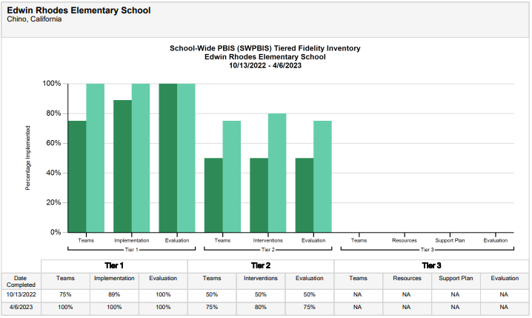
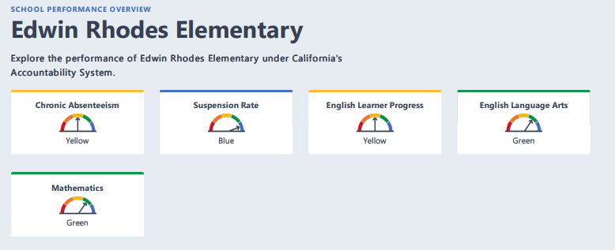
PBIS TFI Results 22-23 School Year
Year By Year Comparisons of PBIS and Academic Outcomes
CA Dashboard 22-23 School Year
Notes:
Instructions: You can clip/post any, or all of the Academic Outcome indicators within the CA Dashboard, as long as the same indicator is used for the year-by-year comparisons.

